Slide 1

iOS Application Security

Slide 2


Trail of Bits
Est. 2012 to advance computer security
Software Development
Security Assessment
Security Engineering
Reverse Engineering
Mobile Security
Directed Original Research
Dan Guido
Sophia D’Antoine
CEO
Security Engineer
dan@trailofbits.com
sophia@trailofbits.com
@dguido
quend@freenode

Slide 3
Agenda
iOS Security Overview
Mobile Application Attacks
Protections from Apple
Jailbreak Development
Attack Walkthrough
Compiler-Driven Defenses

Slide 4
iOS Security Model
Application Layer
Transport Layer Security
NSURLConnection and NSURLSession use ATS
ATS requires TLS 1.2 and strong certificates
Apps must opt-out*
It’s easy to do network encryption right with iOS9
Data Protection
Encrypt every file with a unique 256-bit key
Per-file keys are wrapped with a “class” key
class = security policy
Nearly all files are strongly encrypted on disk
Notes:
Here are some security buzzwords you may have heard before and what they mean
These are features Apple uses to protect you

Slide 5
iOS Security Model
Operating System Layer
Application code signing
Verify your identity with Apple
Sign your app
Every code page in memory is checked
Every 4kb page is traceable back to a human owner
Runtime process security
Apps run in a sandbox
Apps are restricted from accessing other apps
System files and resources are shielded
It’s hard for even malicious apps to cause trouble
Notes:
These are features that Apple uses to protect themselves

Slide 6
iOS Security Model
The iPhone
Secure Enclave
Unique device key fused at manufacture time
Keys can never be read out of the Secure Enclave
Black box for encrypt and decrypt operations
This protects Apple Pay and Data Protection (Keychain)
iOS Partition
Sandbox
Encrypted File System
Developer App
Cert
iOS Apps
Kernel
Secure Enclave
Notes:
New stuff! Secure Enclave is how they protect Apple Pay.

Slide 7
iOS Application Security

Slide 8

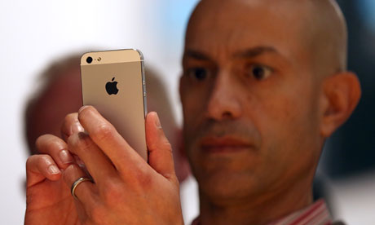
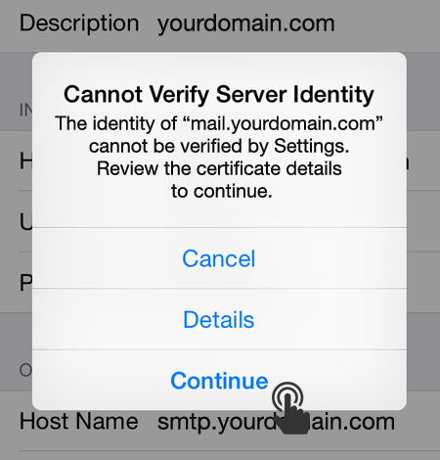
Wireless Interception
Internet
Notes:
MITM / Proxy
Reverse engineer an API spec from network traffic

Slide 9
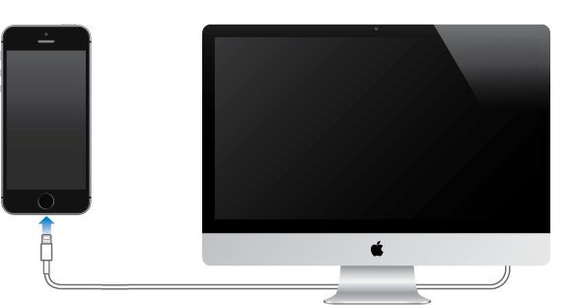
Data Leakage
Internal app data (e.g. session IDs) is easily lost in backups
iTunes backups default to no encryption
New backup made every time you plug in
Windows and OS X commonly get malware
See “BackStab” malware

Slide 10

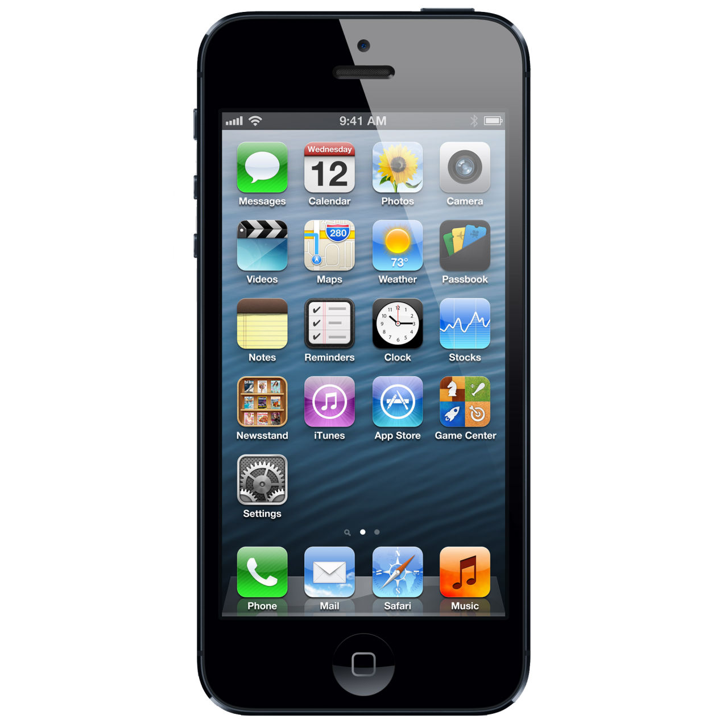
Data Leakage
It’s up to developers to use PIN-derived data protection
Forensic acquisition software is available for iOS
Ex. Elcomsoft iOS Forensic Toolkit and NowSecure Forensics
All tout “3rd party app support” – acquire data from Snapchat, Outlook…
No passcode required (but even those are easy to brute force)
This is data that’s potentially exposed when you lose your phone
If you’re making a business of stealing iPhones, $1k is worth paying

Slide 11
Malicious Applications
You may leave data in places where malicious apps can find it
UIPasteboard Scenario
Frequently used for sensitive data transfer
1Password, one-time tokens, visited URLs…
Malicious apps can hook copy-paste to archive
Example Exposed Data
URL cache
Keyboard cache
App backgrounding
Logging
HTML5 data storage
Cookie objects
Analytics

Slide 12
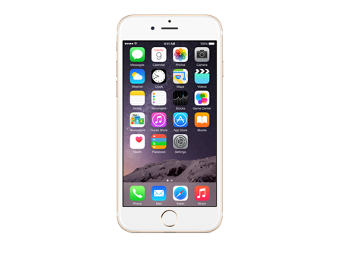
Attacks Recap
Network
Physical
Other Apps
Desktop
Notes:
Pervasive data leakage via Network, Desktop, Physical, App

Slide 13
TLS & Certificate Pinning
Use TLS exclusively and pin your server cert inside your app
Read the Apple docs for secure networking and adopt ATS
E.g., when using NSURLRequest, make sure to specify https in the URL
App Transport Security (ATS) fully enabled prevents nearly all failures
Use TrustKit for effortless and universal certificate pinning
No code modifications, it swizzles NSURLConnection and Session
Certificate validation failures are reported to a configurable location
Can be easily deployed using CocoaPods or by hand
Notes:
https://developer.apple.com/library/ios/documentation/General/Reference/InfoPlistKeyReference/Articles/CocoaKeys.html#//apple_ref/doc/uid/TP40009251-SW33

Slide 14
Data Protection & Keychain
Encrypt ALL the things!
DPAPI encrypts app data with the phone passcode + UID key*
Attribute added to NSData or NSFileManager
None, Complete, CompleteUnlessOpen, CompleteUntilFirstAuth
Keychain Services are used to store passwords and tokens
SecItemAdd, SecItemUpdate, SecItemCopyMatching
Attributes determine encryption method:
Always, AfterFirstUnlock, WhenUnlocked, WhenPasscodeSet
Don’t use: Preferences, Cookies, files in /Library or /Documents
Notes:
https://developer.apple.com/library/ios/documentation/iPhone/Conceptual/iPhoneOSProgrammingGuide/StrategiesforImplementingYourApp/StrategiesforImplementingYourApp.html#//apple_ref/doc/uid/TP40007072-CH5-SW21

Slide 15
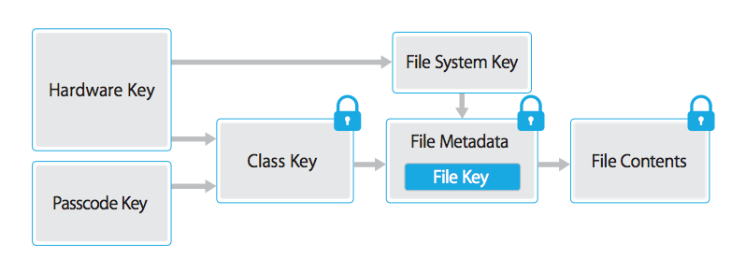
Data Protection API
Why Apple and the police can’t read your phone contacts
Passcode “tangled” with Hardware Key = must crack on-device
Pre-iOS 7: Mail.app the only default app to use DPAPI
iOS 8: Most Apple apps default to CompleteUntilFirstAuth
iOS 9: 6-digit passcode required + exponential backoff
Notes:
UID stored in Secure Enclave, exponential backoff per attempt, 4 digits were unfeasible, 6 is astronomical
After 9 guesses, it locks you out for an hour each time
http://blog.cryptographyengineering.com/2014/10/why-cant-apple-decrypt-your-iphone.html

Slide 16
Data Minimization
iOS apps leave data in a lot of unexpected places
Prevent sync to iCloud or iTunes
NSURLIsExcludedFromBackupKey/kCFURLIsExcludedFromBackupKey
Clear background screenshots
Check applicationDidEnterBackground and set fields ’hidden’ = YES
Avoid using NSLog for sensitive or proprietary information
Use a dummy pre-processor macro `#define NSLog(…)`
Keep sensitive data out of the Keyboard cache
secureTextEntry (password-style entry)
UITextAutocorrectionTypeNo (disable autocorrect)
Notes:
https://developer.apple.com/library/ios/qa/qa1719/_index.html
https://developer.apple.com/library/ios/documentation/UIKit/Reference/UITextInputTraits_Protocol/#//apple_ref/occ/intfp/UITextInputTraits/autocorrectionType

Slide 17
App Security Recap
It’s like BuzzFeed, for Mobile App Security
Follow these 3 rules for every iOS app you make:
Use HTTPS exclusively
Store all files, passwords, and tokens with DPAPI or Keychain
Clean up after your app and don’t leave sensitive data lying around
These are just the basics. Level two includes:
Custom URL Handlers, XSS in UIWebViews, Format Strings,
Directory Traversal, Null bytes, XML parsing, SQL injection, and more!
Notes:
Many recent iOS 9 security enhancements:
System pasteboard can’t be read when app is in background
openURL has extra prompts for URL handlers now
http://www.andreas-kurtz.de/2014/09/malicious-apps-ios8.html
https://stackoverflow.com/questions/33408048/ios-9-pasteboard-not-able-to-write-in-pasteboard-while-in-background

Slide 18
Jailbreaks

Slide 19
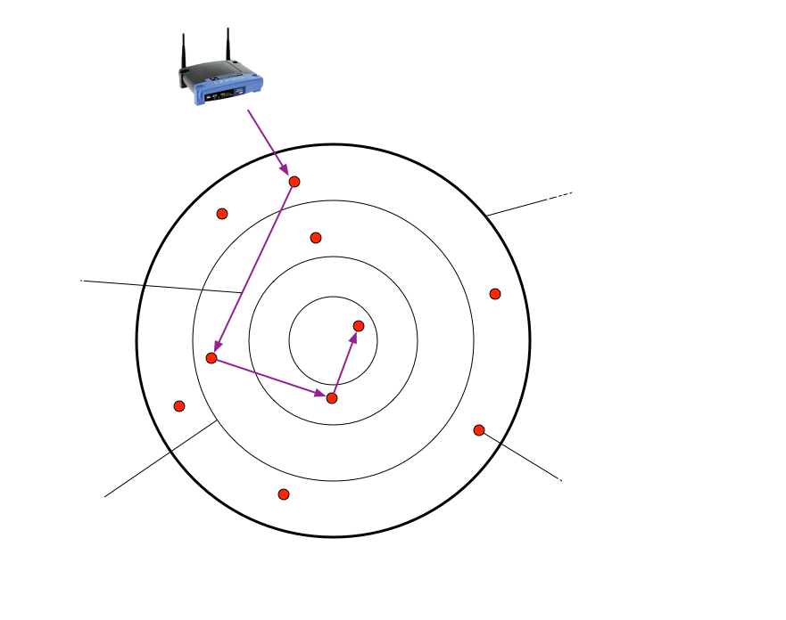
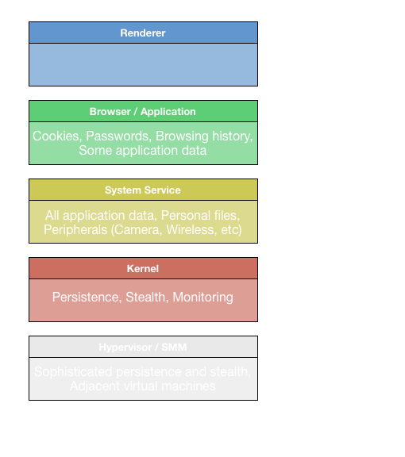
What are Jailbreaks?
Exploit code that disables security mechanisms
Notes:
Apple makes this really hard. Teams of people working for months on end, bypassing layer after layer of protections.

Slide 20
Why Jailbreak?
Jailbreak maliciously through browser or app
If you want to:
Obtain application code
Reverse an API Spec
Steal copyrighted content
Pirate paid apps
Commit fraud
Jailbreak voluntarily by downloading a kit
If you want to:
Access 3rd party appstores
Tether for free
Replace default apps
Customize look and feel
Device unlocking
The end result is the same. All application protections are dead.

Slide 21
KeyRaider
This is your phone. This is your phone on Jailbreaks.
The iPhone
Application data is strongly protected by sandboxing and iOS security model
Without these protections, a malicious app can bypass ALL device security
Keyraider stole Apple ID creds from 225,000 devices for in-app purchases
iOS Partition
Sandbox
Developer App
Cert
KeyRaider
iOS Apps
Secure Enclave
Notes:
http://researchcenter.paloaltonetworks.com/2015/08/keyraider-ios-malware-steals-over-225000-apple-accounts-to-create-free-app-utopia/

Slide 22
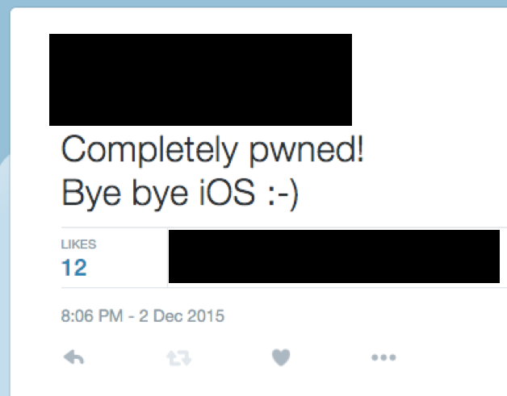
Jailbreak Takeaways
You cannot always depend on Apple’s APIs to protect you
Users will ‘attack’ themselves
Up to 7 million voluntarily jailbreak
Existing Jailbreaks used for attacks
Delivered via browser or user-generated app content
New Jailbreaks not always public
Active community of people, knowledge, tools for hacking iOS

Slide 23
Jailbreak Protections

Slide 24
Injected Code
Application Code + Security Code
App code
Developer App

Slide 25
Jailbreak Checks
Detect an unsafe or tampered environment
Detect system artifacts left over from successful jailbreaks
Relies on complete understanding of iOS internals and the jailbreak
Many apps implement naïve checks
Check for MobileSubstrate.dylib, ssh, Cydia.app files
Check if the fork() system call is available
More basic ideas at project-imas/security-check

Slide 26
Injected Code
Application Code + Security Code
App code
Developer App
Jailbreak Detection

Slide 27
Anti-Debugging
Deny attempts to debug or hook the application
Attackers can bypass Jailbreak checks with a debugger
Ex. Snapchat checks are bypassed by hooking filesystem calls
Download tsProtector 8 or xCon for point-and-click bypass!
Dynamic, anti-debugging must accompany jailbreak checks
Ex. Use sysctl to ask who your parent is. If it’s not launchd or the kernel, you’re being debugged! Either exit or alter execution.

Slide 28
Injected Code
Application Code + Security Code
App code
Developer App
Jailbreak Detection
Anti-debugging

Slide 29
Anti-Reversing
Deny the ability to understand the recovered code
Attacker could disassemble the app and patch out security checks
Simple to do with IDA Pro, Hopper, or Binary Ninja
Static protections can destroy the utility of this approach
100x more code to look through, inability to search through it
Symbol encryption, false predicates, and code diffusion…

Slide 30
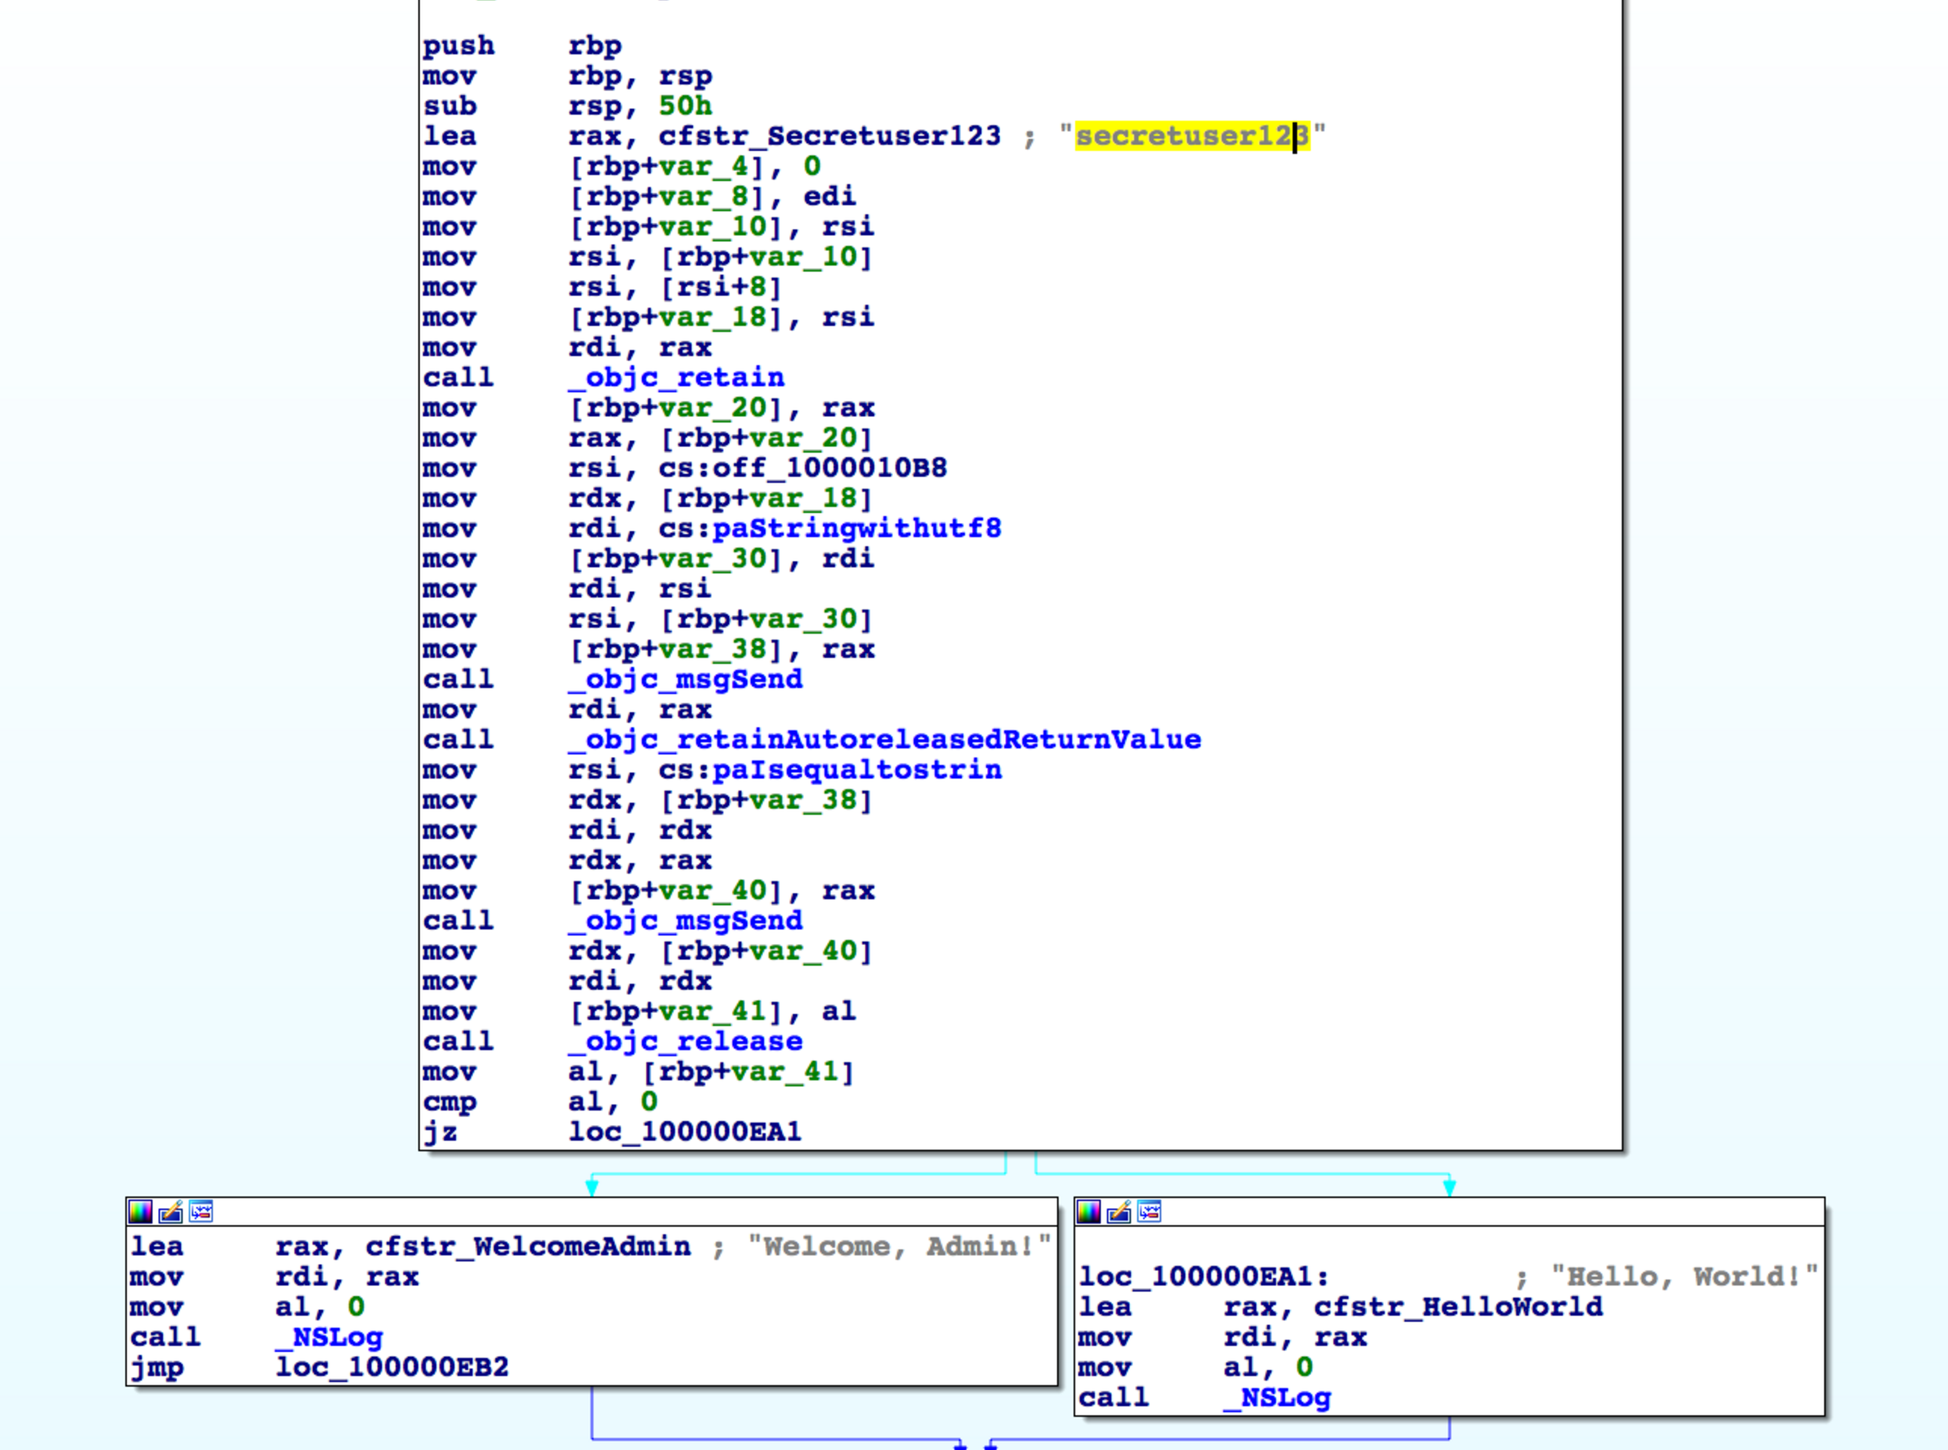
Anti-Reversing
Original application as viewed in IDA Pro
Notes:
Further explain symbol encryption, predicate insertion, and code diffusion aided by a graphic
Performance

Slide 31
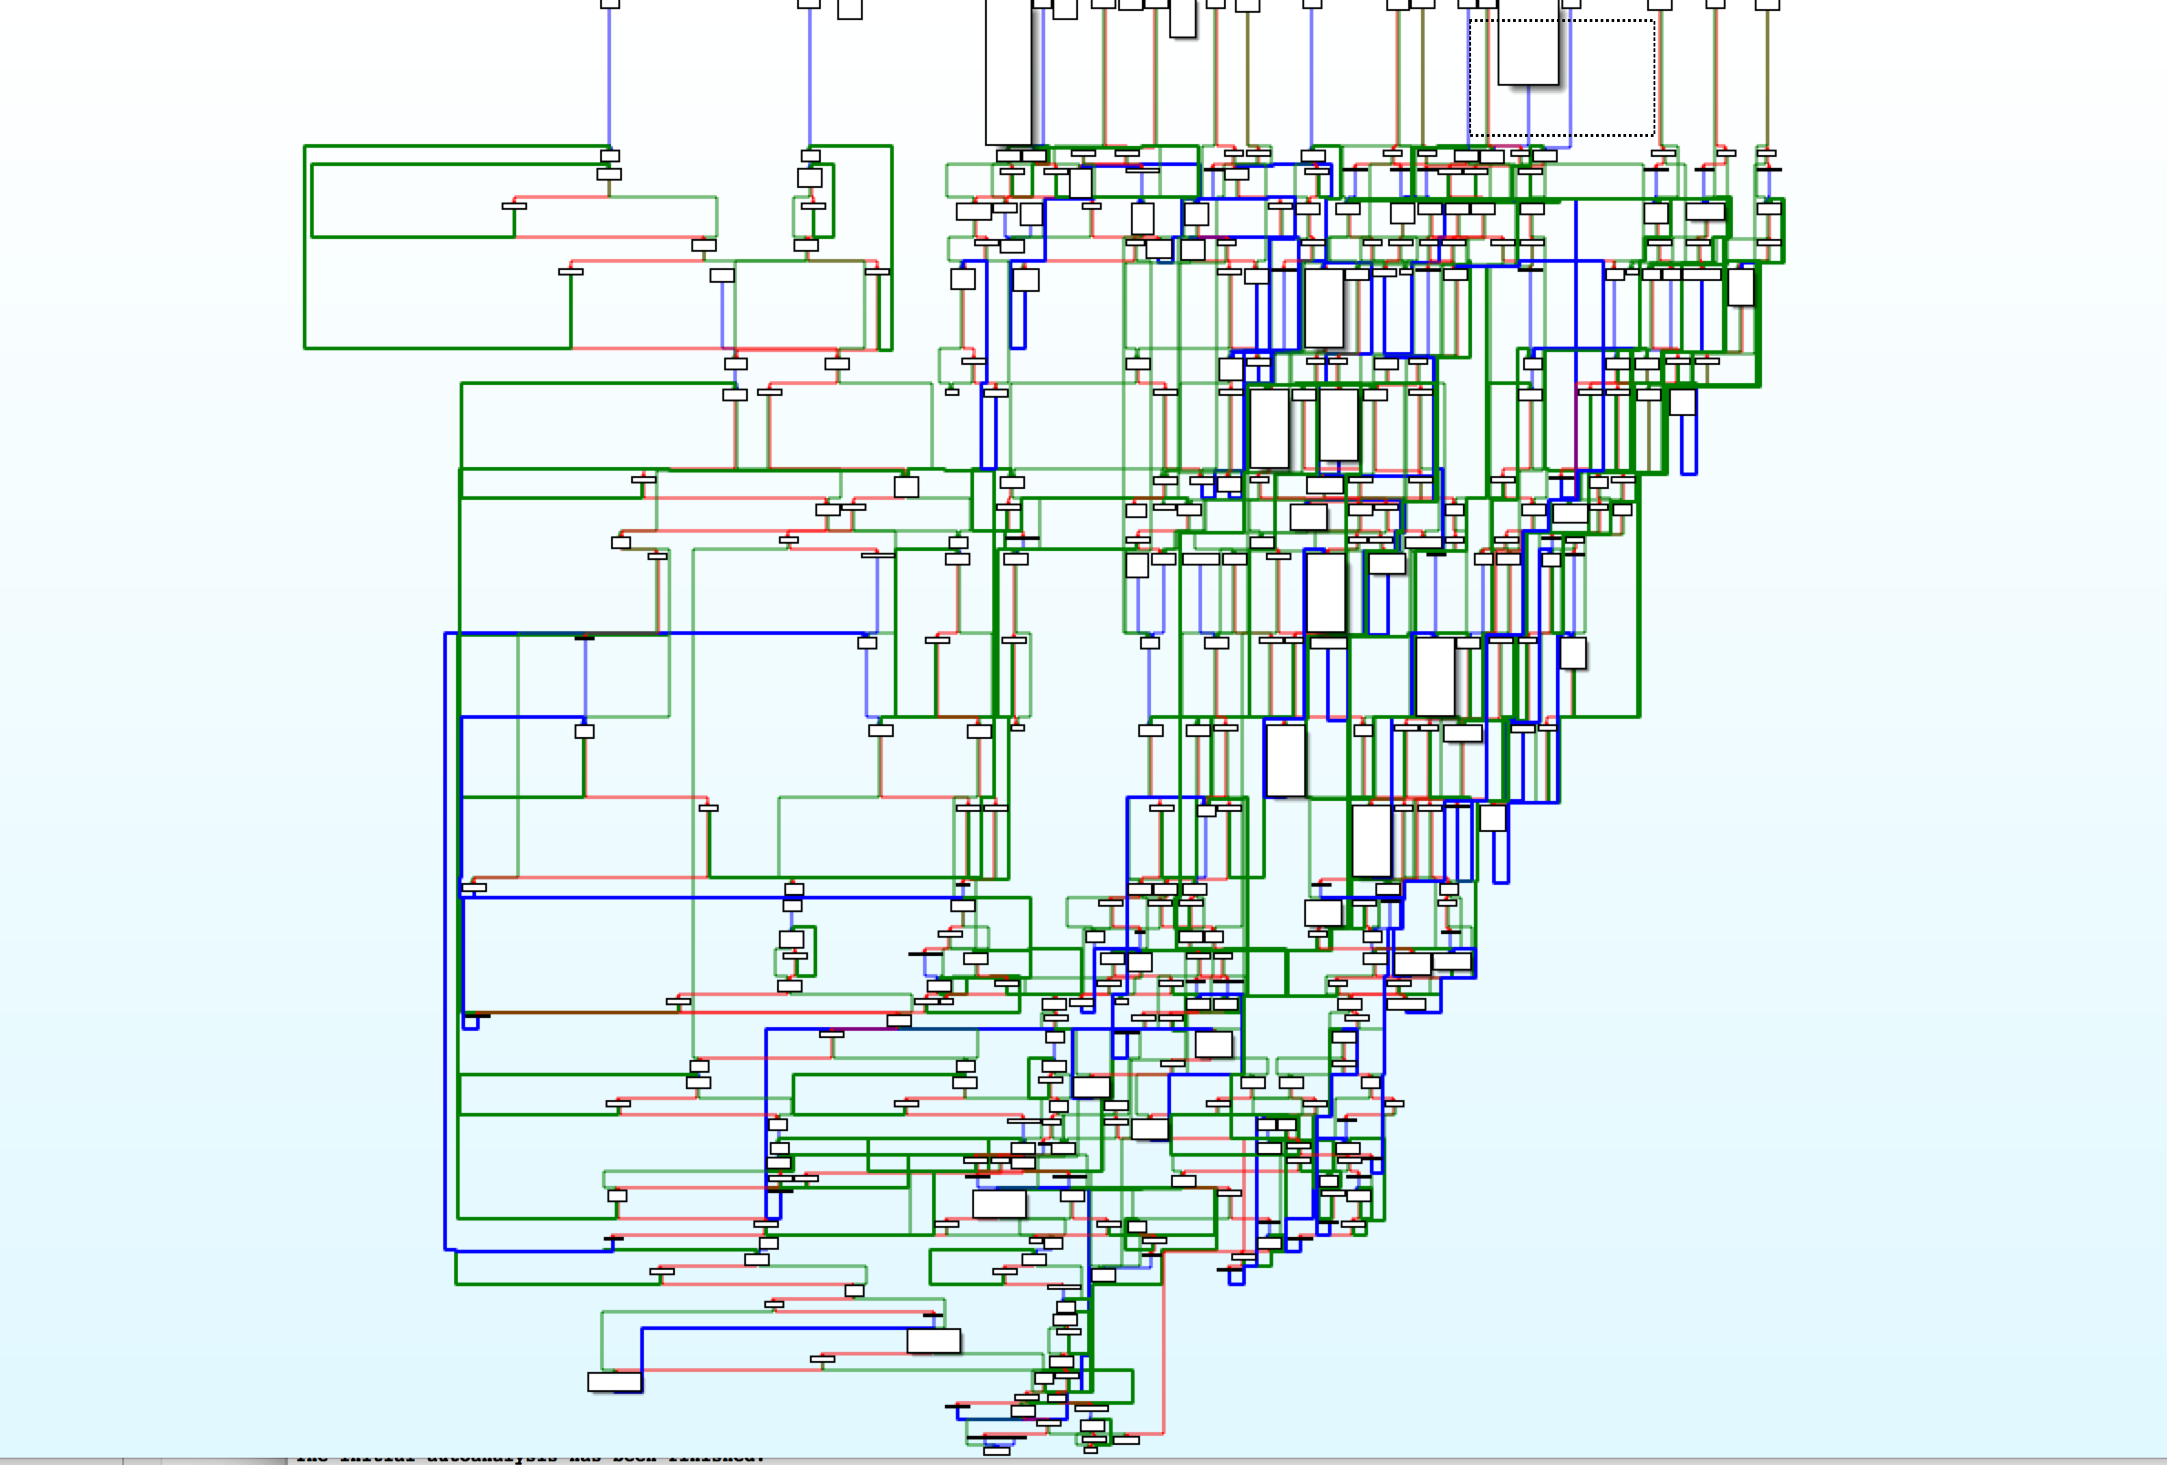
Anti-Reversing
Obfuscated applications have more code to reverse
Notes:
Further explain symbol encryption, predicate insertion, and code diffusion aided by a graphic
Performance

Slide 32
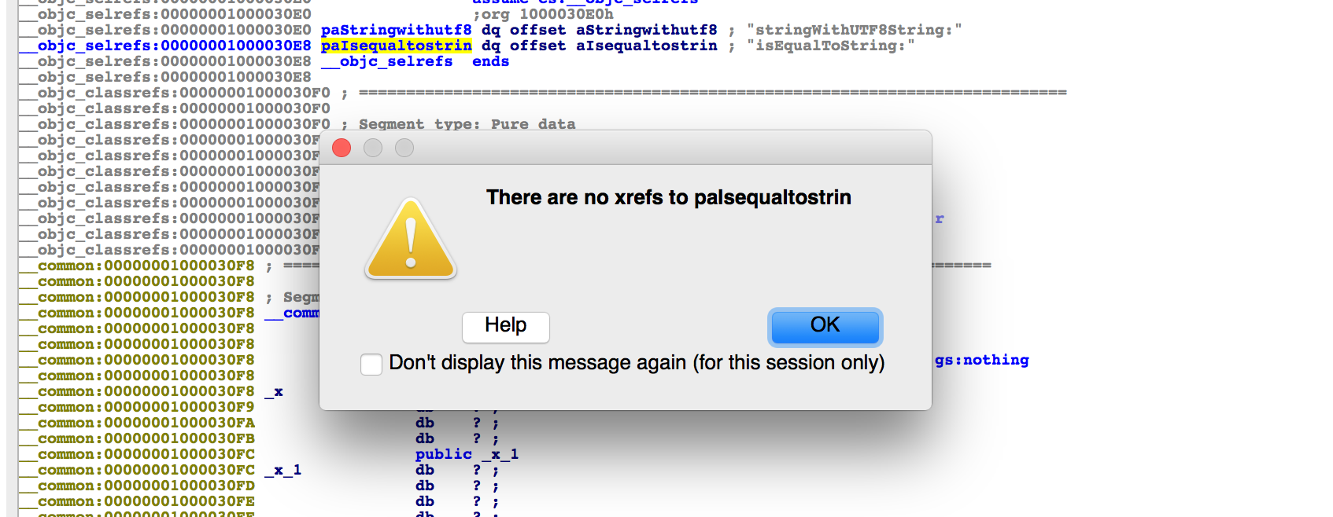
Anti-Reversing
Symbol encryption makes binary code navigation impossible
Notes:
Further explain symbol encryption, predicate insertion, and code diffusion aided by a graphic
Performance

Slide 33
Imagine a consulting gig…
The software development project from hell:
Sorry, you have to use only this Windows XP box for dev
Sorry, our devs were drunk and named all the vars a, aa, aaa
Sorry, we have 10mil LOC but only 10k are used. We don’t know which.
Sorry, our code won’t run in a debugger, it will crash
Sorry, ctags won’t run on our code
…
Good luck adding new features to our app! You’re going to do great!

Slide 34
Injected Code
Application Code + Security Code
Anti-Reversing
App code
Developer App
Jailbreak Detection
Anti-debugging

Slide 35
Integration
Protections are only effective if universally applied
Apps are only challenging to reverse if ALL the code is protected
Don’t leave it to programmers to add in checks everywhere needed
It is hard to influence the binary through code or linking
Applying protections right means modifying your compiler
XCode is based on LLVM, an open-source compiler
LLVM supports “transforms” to modify code during compilation

Slide 36

Integration
Protections are only effective if universally applied
Apps are only challenging to reverse if ALL the code is protected
Don’t leave it to programmers to add in checks everywhere needed
It is hard to influence the binary through code or linking
Applying protections right means modifying your compiler
XCode is based on LLVM, an open-source compiler
LLVM supports “transforms” to modify code during compilation

Slide 37
Compiler Walkthrough
App
Source Code
XCode
Compiler Stages
App code
App
Obj
App Link
App Bin

Slide 38

The End Result
App
Source Code
XCode
Compiler Stages
App code
App
LLVM
BC
App
Obj
App Link
App Bin

Slide 39
Doing this yourself
LLVM is orders of magnitude easier to use than GCC
LLVM Overview: www.aosabook.org/en/llvm.html
Writing an LLVM Pass: llvm.org/docs/WritingAnLLVMPass.html
LLVM Tutorial: cs.umd.edu/~awruef/LLVM_Tutorial.pdf
Our interview process begins with an LLVM pass work-sample test
Notes:
Alex w/ GCC VulnCheck vs InternChallenge w/ LLVM

Slide 40

Getting it done for you
Contact us for more details (mast@trailofbits.com)
Notes:
Alex w/ GCC VulnCheck vs InternChallenge w/ LLVM

Slide 41
Conclusions

Slide 42
Protect Your App
Use all the tools that Apple gives you and then some!
It’s easier to abuse applications without basic protections
Use HTTPS exclusively: Apple Transport Security (ATS) and TrustKit
Use Data Protection or Keychain Services on all private data
Inventory the sensitive data in your app and eliminate it when possible
However, Jailbreaks bypass all app protections
Embed protections that determine device integrity inside your app

Slide 43
Questions?
Thanks for having us!
If you like this kind of work, come to Empire Hacking
If you have high security needs, talk with us about MAST
If auth is more your thing, www.passwordlessapps.com
Dan Guido
Sophia D’Antoine
CEO
Security Engineer
dan@trailofbits.com
sophia@trailofbits.com
@dguido
quend@freenode

Slide 44
References
More Information on iOS Application Security
Protecting Your App
iOS Security Guide
Security Changes in iOS9
Protecting Against Screen Caching
Writing Secure iOS Applications
Modern Threats to Your App
Stealing an App’s Custom API’s
Current Example of iOS Malware
Simple Jailbreak Detection Bypass
Mobile Threat Analysis: 2015

Slide 45
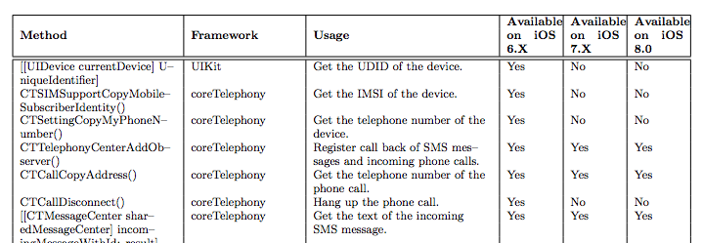
EnPublic Apps
How malware abuses Apple Private APIs
Run class-dump on frameworks in iOS SDK --> private APIs
Apps distributed w/ ad-hoc provisioning can use private APIs
EnPublic attacks documented in paper at Asia CCS 2015
Notes:
http://www.cse.cuhk.edu.hk/~cslui/PUBLICATION/ASIACCS15.pdf
Masque attack vulns patched out in 8.x series
https://www.fireeye.com/blog/threat-research/2015/06/three_new_masqueatt.html

Slide 46
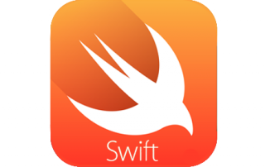
Bitcode App Submission
An opportunity for security improvements?
Swift XCode projects automatically include LLVM BC
Bitcode is embedded into your app during archive builds (see ‘ENABLE_BITCODE’)
Apple can perform optimizations and transformations in the cloud for iWatch power usage or app thinning
Bitcode submission likely to become standard
Note: Compiling to bitcode does not introduce any new security issues into your application code.
Notes:
https://developer.apple.com/library/tvos/documentation/IDEs/Conceptual/AppDistributionGuide/AppThinning/AppThinning.html#//apple_ref/doc/uid/TP40012582-CH35-SW2

Slide 47
Why not Android?
Anti-jailbreak code is nearly impossible to write for Android
Let’s ignore…
That < 5% run the latest version of Android…
HW fragmentation issues and lack of ‘Secure Enclave’-alike…
The, usually insecure, OEM customizations…
The lack of whole-system code signing...
Cyanogen Mod is an officially supported Android distribution!
‘su’ is a valid, accessible binary for Android distributions
Millions of people run Cyanogen Mod and expect it to work
That said, anti-reversing/debugging code works on Android

Slide 48
How about overhead?
Armoring gets in an attacker’s way, not regular users
Anti-jailbreak and anti-debug checks have very little overhead
They are single instructions that run between other code
Even so, you can add more or less of them via compiler options
Anti-reversing adds lots of code, but hardly any is ever run
Opaque predicates insert dead code that never gets executed
Symbol encryption is not computationally difficult
End of the day, expect ~5-10% CPU/memory increase
On the other hand, binary size may inflate with all the dead code

